Slide 1

Beyond Fake News: Exploring the Ethics of Misinformation on Social Media

Slide 2
Introduction
Misinformation is a significant issue on social media platforms
Discussing the ethical issues surrounding misinformation and its impact on society
Notes:
Good morning/ everyone. Today, I'm going to talk about the spread of misinformation on social media and the ethical issues surrounding it from a data ethics perspective. Misinformation can have a significant impact on our society, and it's important that we take this issue seriously. I'll begin by discussing what misinformation is and how it spreads on social media, and then examine the ethical issues from a data perspective.

Slide 3
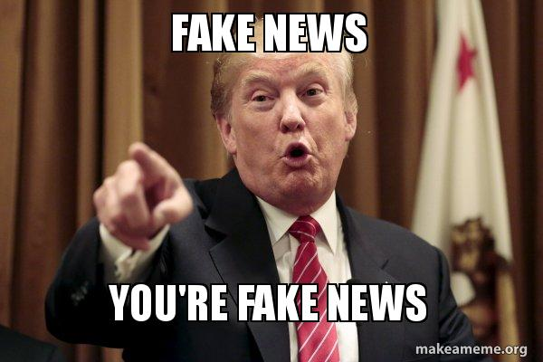
What is Misinformation?
Misinformation refers to false or inaccurate information that is spread intentionally or unintentionally
Misinformation can cause harm to individuals and society
Social media platforms have been criticized for their role in spreading misinformation and fake news
Notes:
Misinformation refers to false or inaccurate information that is spread either unintentionally or deliberately. Social media platforms have been criticized widely for their role in helping to spread misinformation and fake news. Some key real-life examples of this is:
Covid-19: vaccinees cures, severity and origin
- Lead to people making dangerous health decisions
Brexit impact on economy - influenced out come
January riots - conspiracy theroies factor in
climate change - denial, causes and effects lead to lack of action serious consequences on enviornement and our health

Slide 4

How Misinformation Spreads on Social Media
Misinformation can spread on social media through various means, such as user-generated content, algorithmic amplification, bots and trolls, and echo chambers
Social media algorithms can amplify false or misleading content to increase engagement
Automated accounts and fake profiles can spread misinformation to a large audience
Notes:
Misinformation can be spread on social media through means such as:
User-generated content: Users can create and share content that is false or inaccurate.
Algorithmic amplification: Social media algorithms can amplify false or misleading content to increase engagement. Social media companies use affirmation from users, not challenge, to power their business modles. - Social media companies implement AI/ML technologies on their big data to drive their persuasive and manipulative algorithms in order to retain users attention, and to increase the amount of time they spend on the platform. In essence, they’re using your data to provide content that conforms to your world views…
Bots and trolls: Automated accounts and fake profiles can take false information and spread it to a wide audience.
Echo chambers: Users are exposed only to information that confirms their existing beliefs and biases. Twitter, for example, has 350 million individual Truman Shows. Where users are living out their own experiences.

Slide 5
Ethical Issues Related to Misinformation on Social Media from a Data Ethics Perspective
The right to free speech vs. responsibility
The role of social media companies
The impact of misinformation on individuals and society
The importance of data ethics in addressing misinformation on social media
Notes:
The spread of misinformation on social media raises several ethical issues related to data ethics, including:
Privacy and data protection: Social media companies have access to massive amounts of user data that can be used to spread misinformation. Which can raise concerns about privacy and data protection.
Algorithmic transparency and accountability: Social media algorithms that amplify misinformation may lack transparency, and their decisions are not held to account through regulation or policy. Facebook, in 2018, implemented a new algorithmic feature which suggested similar groups to groups users were added to. For example, if I joined an Arsenal group, it would then suggest a football group focused on the premier league. A recent report has found that of all users on harmful groups (for example, groups spreading terrorism, QANPN), 64% of those users joined those groups as a result of the suggestion feature.
The impact of misinformation: Misinformation can cause harm to individuals and society, and social media companies have a responsibility to minimize that harm through responsible data ethics practices.

Slide 6
Solutions to Tackle Misinformation on Social Media from a Data Ethics Perspective
Fact-checking
Algorithmic transparency
Education and media literacy
User reporting and moderation
The role of data ethics in developing effective solutions
Notes:
There are several solutions that can be implemented to tackle the spread of misinformation on social media from a data ethics perspective, such as:
Privacy by design: Social media companies can design their platforms to protect user privacy and limit the use of data that can be used to spread misinformation.
Algorithmic transparency and accountability: Social media algorithms can be made more transparent to prevent amplification of false or misleading content, and there should be accountability for the decisions made by these algorithms.
Education and media literacy: Increasing media literacy can help users to identify and avoid false information.
User reporting and moderation: whilst social media platforms have the ability for users to report harmful content, social media platforms should take an extra step to provide users with tools to report false information and moderate content.

Slide 7
Conclusion
The spread of misinformation on social media is a complex issue that requires a multifaceted approach to tackle
The importance of addressing the ethical issues surrounding misinformation
The potential impact of effective solutions in promoting a more informed society
Encouraging continued discussion and action on this critical issue.
Notes:
In conclusion, the spread of misinformation on social media is a complex issue that requires a multifaceted approach to tackle from a data ethics perspective. Social media companies, governments, regulators, and users all have a role to play in addressing this issue. By implementing solutions such as privacy by design, algorithmic transparency and accountability, education, and user reporting, we can reduce the impact of misinformation and promote a more informed society that values data ethics.

Slide 8



Don’t be gullible

